Slide 1

Title Page
Problem Statement ID – 1593
Problem Statement Title – Student Innovation
Theme- Robotics and Drones
PS Category – Software
Team ID –
Team Name (Registered on portal)- Polluxpenguin

Slide 2
IDEA TITLE
Polluxpenguin
Problem Resolution :
RAG-LLM System offers unbeatable context awareness
Large Vision Models combined with traditional predictive AI provide for enhanced Spatial and visual awareness
IDEA / SOLUTION :
Development of a real-time GNC Assistant specialized for optimizing drone applications in critical missions like medical emergencies and search and rescue.
RAG-LLM Centered Control for enhanced and simplified drone operations.
Multiple LLMs work in tandem for contextual and spatial awareness
Provides a framework for drone control hardware to efficiently interact with Large Language Models
Unique Value Propositions (UVP) :
Use of traditional Computer Vision software to enhance information extraction from the environment.
Highly customizable system prompt (text based) with virtually unlimited hardware connection possibilities

Slide 3
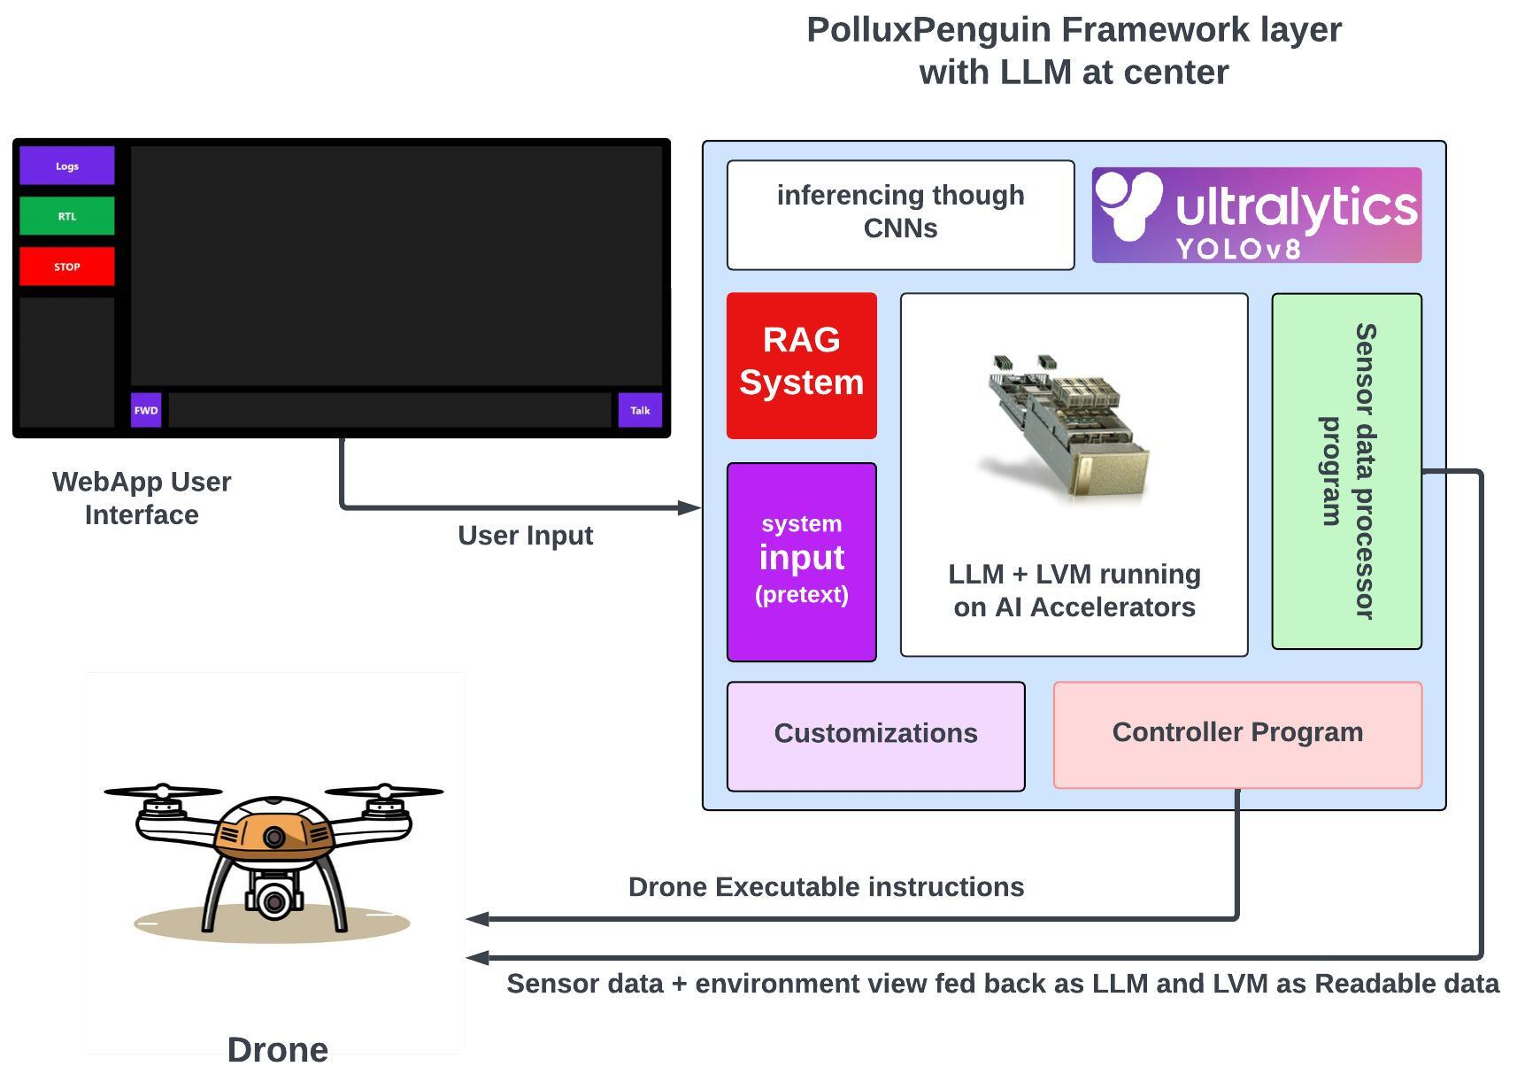
TECHNICAL APPROACH
Polluxpenguin
PROCESS FLOW ARCHITECTURE
Algorithm Development:
Python and Bash – Core technologies used to implement the computation and control systems
Application Development:
React JS + Vite for the frontend web application with Node.js used for backend Framework testing:
Different Ports were written for different LLMs (Google’s Gemini, OpenAI’s ChatGPT, their frontier and free-tier models) GAZEBO + ROS for simulation of drone dynamics using Ardupilot’s iris arducopter on Linux (Ubuntu 20.04 LTS)

Slide 4
FEASIBILITY AND VIABILITY
Polluxpenguin
Feasibility:
Technical: Integrating LLM with RAG for MAVLink is feasible due to its structure. Multimodal vision boosts navigation, and natural language input enables scalability across hardware.
Financial: Initial GPU or cloud costs may be high, but open-source components can lower long-term expenses, with strong market demand supporting investment.
Market & Operational: The system's adaptability fits agriculture, defense, and logistics, providing a unique hardware integration advantage. Real-world testing and strong troubleshooting will be crucial.
Potential challenges and risks:
Challenges include real-time accuracy, hardware compatibility, high computational costs, and slow market adoption. Robust testing and troubleshooting will be crucial for success.
Strategies for overcoming these challenges:
Use modular testing for hardware integration.
Fine-tune LLMs with existing protocols.
Optimize algorithms to reduce computation costs.
Implement safety protocols and redundancy.
Use reinforcement learning for adaptability across environments.

Slide 5
IMPACT AND BENEFITS
Polluxpenguin
Potential impact on the target audience
Positive- Improvement , Economical, New Opportunities, socialbenefits negative- Cost, Technology Adoption Issues
Benefits of the solution (social, economic, environmental, etc.)
Social - Improved Access, Empowerment, Reduction
Economic – Productivity, Cost, Market
ENV – Energy, Reduction, Waste

Slide 6
RESEARCH AND REFERENCES
Polluxpenguin
Details / Links of the reference and research work
Elsevier , Science Direct
`

